Slide 1
The observer design pattern - angular

Slide 2
Agenda
The Observer Design Pattern (OOP)
Anatomy of The Observer Design Pattern
Why The Observer Design Pattern?
An Example of The Observer Design Pattern in Plain TS
Introduction to Observables in RxJS and Angular

Slide 3

“Don’t be a scripter, but understand what is going on inside the code”
- Vulumpus Tulumpus Tumpanus

Slide 4
Observer design pattern
The observer design pattern is a behavioral pattern listed among the 23 well-known "Gang of Four" design patterns.
It defines a one-to-many dependency between objects so that when one object (the subject) changes state, all its dependents (observers) are notified and updated automatically.
In the Observable pattern, one object notifies another object when an action is performed.

Slide 5
Why?
There are two way to check for updated data in a system:
Polling, this is where an object checks in with a global state at a specified interval and check if the state/value has changed, because it will be running for the whole life of the object it is very resource intensive.
The Observable pattern allows for more efficient code as it avoids the issue of having several observers consuming resources to check in with the global state without performing any operations, which can cause an exponential performance decrease, due to the number of existing observers.

Slide 6
Components of the observer design pattern – (Subject)
Subject (Observable) interface: The subject is the object that is being observed. The subject maintains a list of observers (subscribers or listeners). It Provides methods to register and unregister observers, it also defines a method to notify observers of changes in its state.
Concrete Subject: The concrete subject is the object being observed, it implements the subject/observable interface.
It maintains a list of observers, notifies observers of changes in its state, and provides methods to register and unregister observers.

Slide 7
Components of the observer design pattern – (observers)
Observer interface: Observer defines an interface with an update method that concrete observers must implement and ensures a common or consistent way for concrete observers to receive updates from the subject.
Concrete Observer: The concrete observer is the object that observes the subject. It implements the observer interface.
Concrete observers register themselves with the subject to receive notifications.
Concrete observers can also deregister themselves from the observable/subject.

Slide 8
Subjects and observers
The sole responsibility of a subject is to maintain a list of observers and to notify them of state changes.
The responsibility of observers is to register and unregister themselves with a subject (in order to be notified of state changes) and to update their state (to synchronize their state with the subject's state) when they are notified.
This makes subject and observers loosely coupled. Subject and observers have no explicit knowledge of each other.
This notification-registration interaction is also known as the publish-subscribe pattern.

Slide 9
PuSH mechanism of the observer design patter (event-driven architecture)
The Observer Design Pattern typically uses the push mechanism.
In this mechanism, the subject (or Observable) pushes updates to the observers.
When a change in state occurs, the subject pushes the new data to all its observers by calling their `update()` method and passing the updated data as an argument.

Slide 10
Pitfalls
The observer pattern can cause memory leaks, known as the lapsed listener problem, because in a basic implementation, it requires both explicit registration and explicit deregistration.

Slide 11

An example
Consider a scenario where you have a weather monitoring system. Different parts of your application need to be updated when the weather conditions change.

Slide 12
Challenges or difficulties while implementing this system without Observer Design Pattern
Components interested in weather updates would need direct references to the weather monitoring system, leading to tight coupling.
Adding or removing components that react to weather changes requires modifying the core weather monitoring system code, making it hard to maintain.
The Observer Pattern helps decouple the weather monitoring system from the components interested in weather updates. Each component can register as an observer, and when the weather changes, the observers are notified. This way, adding or removing components doesn’t affect the weather monitoring system.

Slide 13
Example – Observer/Subscriber Interface:
The Observer Interface will do two things:
The Observer or the subscriber(just as in YouTube) interface defines a contract for objects that want to be notified about changes in the subject (WeatherStation in this case).
It includes a method update that concrete observers must implement to receive and handle updates.

Slide 14
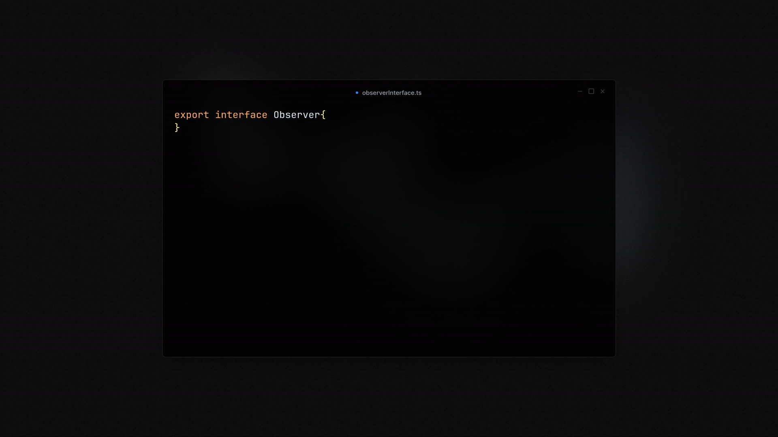

Slide 15
Example – Subject (Observable) Interface
There are three things that the subject interface will do:
The Subject interface outlines the operations a subject (like WeatherStation) should support.
`addObserver` and `removeObserver` are for managing the list of observers. Note that it accepts an Observer as an argument.
`notifyObservers ` is for informing observers about changes.

Slide 16
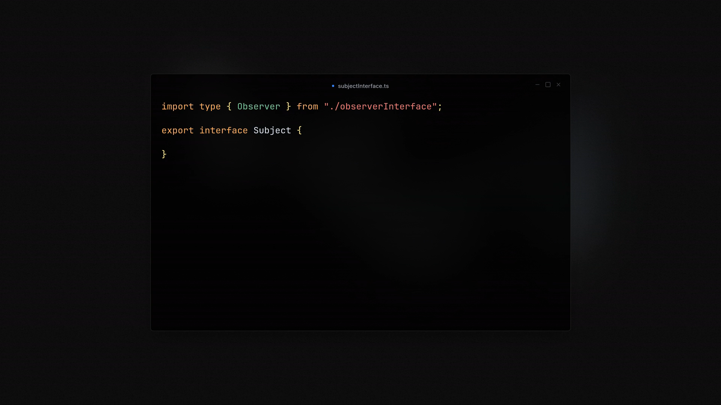

Slide 17
Example – Concrete Subject(WeatherStation)
The concrete subject will also do 4 things:
`WeatherStation` is the concrete subject implementing the Subject interface.
It maintains a list of observers (`Observers[]`) and provides methods to manage this list.
`notifyObservers` iterates through the observers and calls their `update` method, passing the current weather to the observers.
`setWeather` method updates the weather and notifies observers of the change.

Slide 18
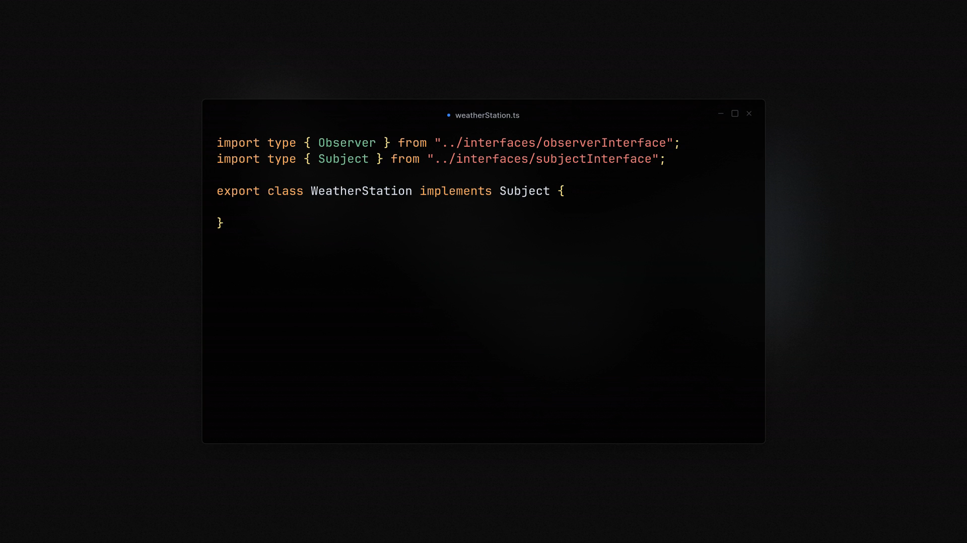

Slide 19
Example – Concrete Observers
All the concrete observers/subscribers will also do these things:
`PhoneDisplay`, `TvDisplay`, and `WatchDisplay` are concrete observer implementing the Observer interface. Thus they all want to receive updates when the state of `weather` changes in the subject.
It has a private field `weather` to store the latest weather.
The `update` method sets the new weather and calls the display method.
`display` methods prints the updated weather to the console.

Slide 20
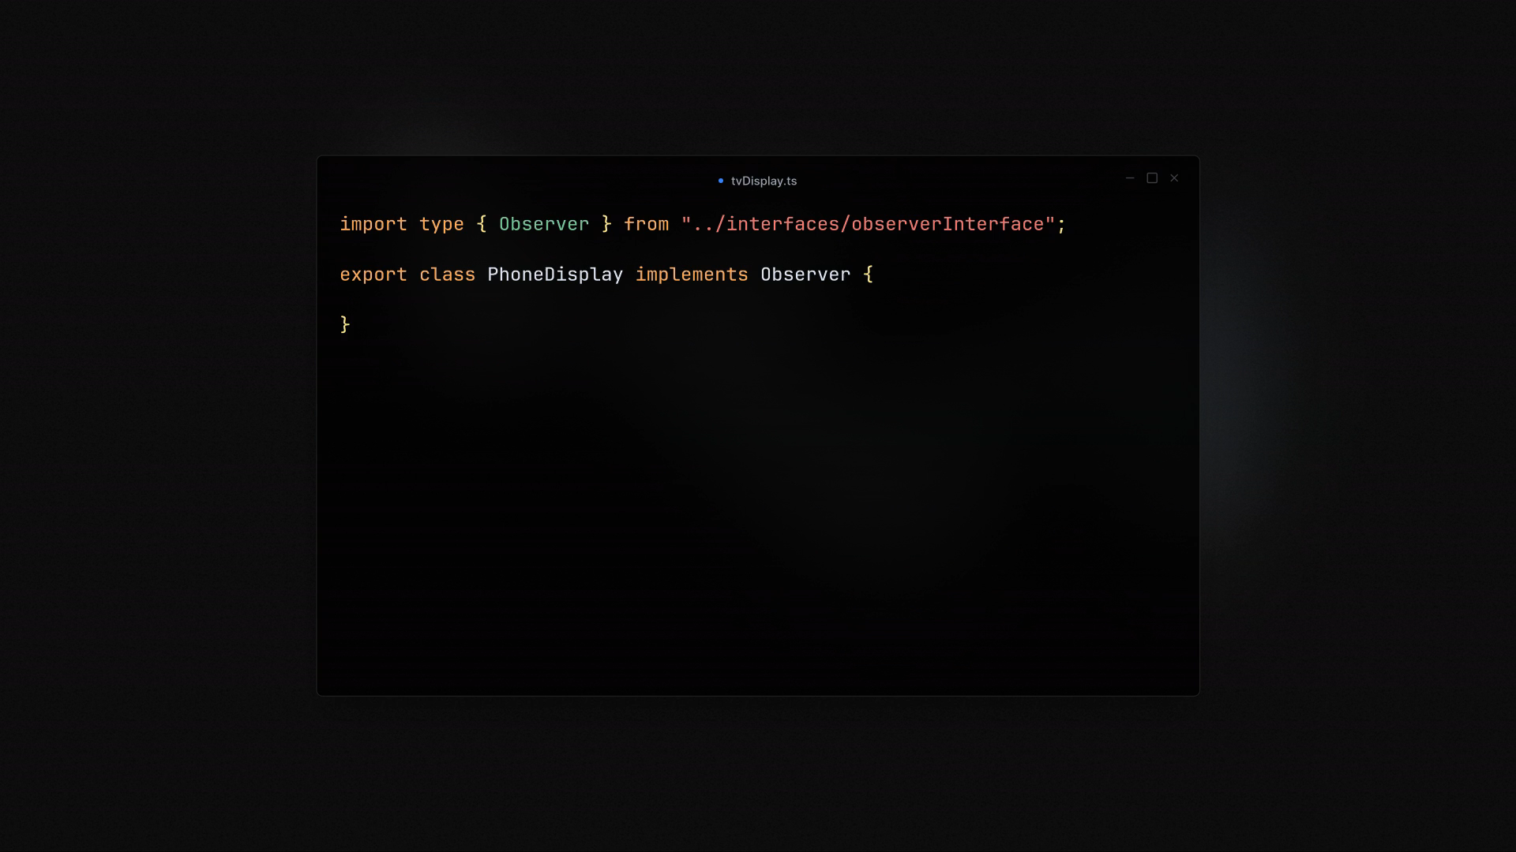
Notes:
TvDisplay

Slide 21
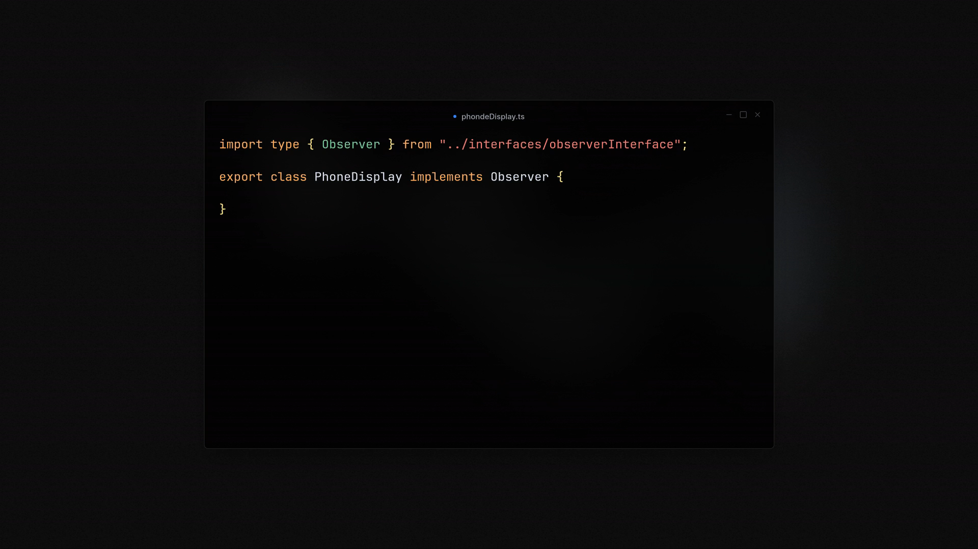
Notes:
phoneDisplay

Slide 22

Notes:
watchDisplay

Slide 23
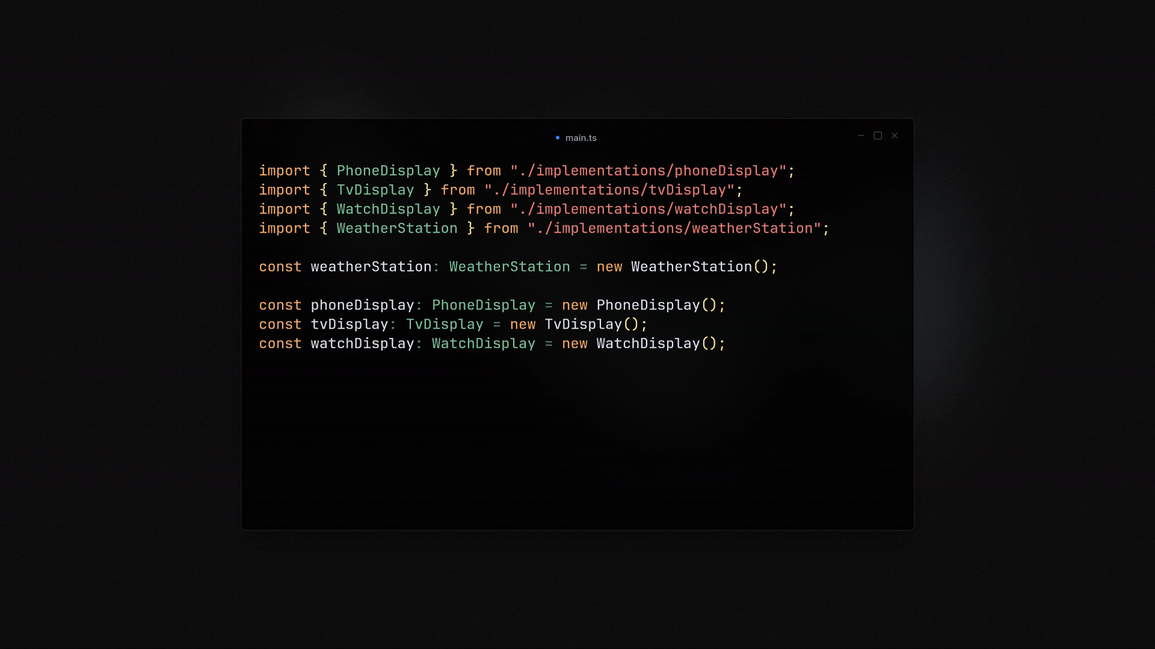
Notes:
Usage

Slide 24
Observables in Angular
In Angular, an Observable is a stream of events or data that happen asynchronously.
A subject/observable is an object that can emit one or more values over time.
An Observer in Angular is an entity that can subscribe to a subject or an Observable.
The Observer reacts to whatever item or sequence of items the Observable emits.
Observables are made possible in Angular by a library called RxJS.

Slide 25
Creating observables in angular
There are two major ways to create observable in Angular(RxJS):
Using `new Subject()`
Using `new Observable()`
Subjects: are multicast by design the observable transmits the same data to multiple receivers(Observers). One-to-Many relationship.
Observers: are unicast by design each observer has its own instance of the data producer(Observable). One-to-One relationship.

Slide 26
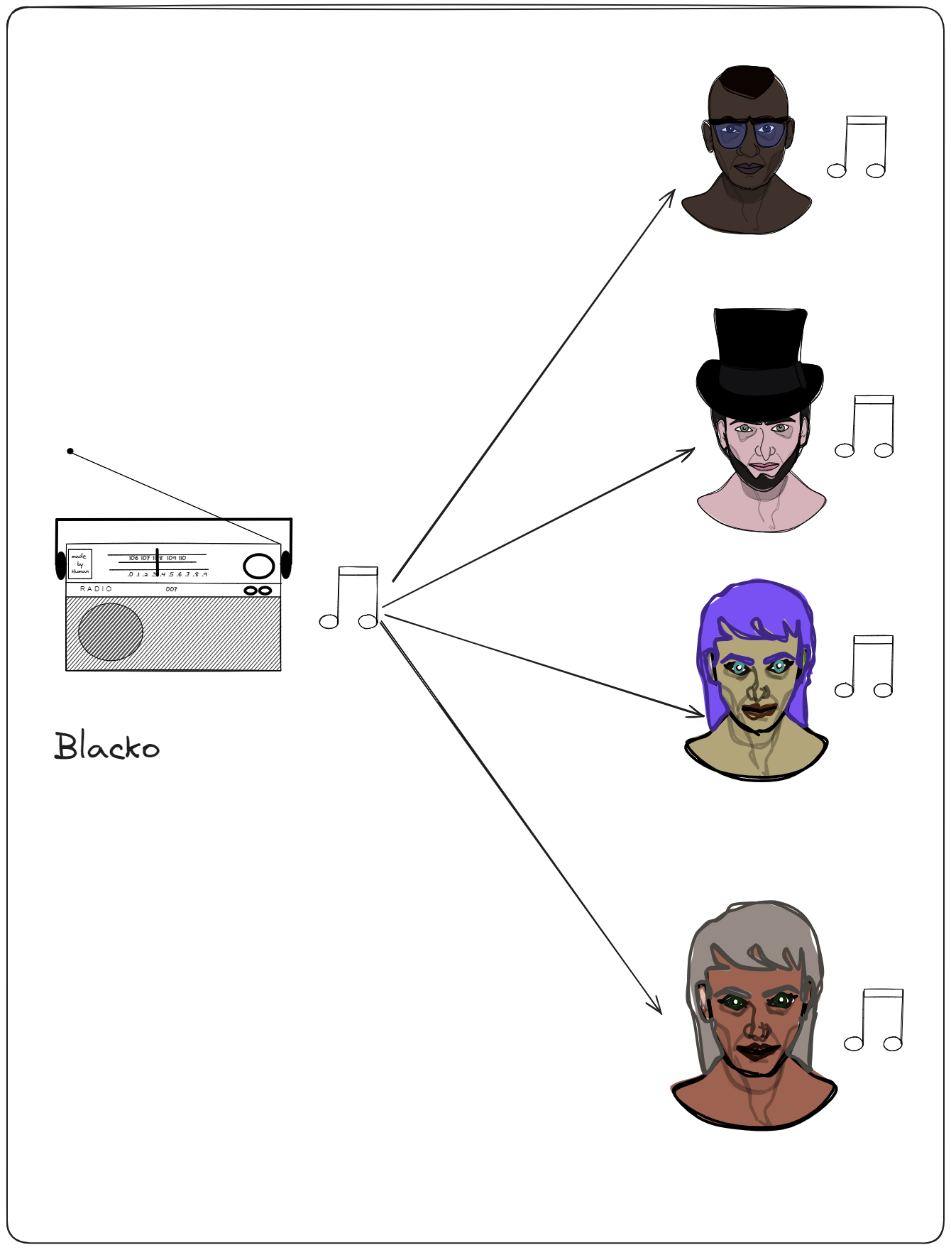
Creating observables in angular: Subject – multicast (one-to-many relationship)
Multicast Observables, share the same execution among all subscribers.
This means that all observers subscribed to a multicast Observable will receive the same set of emitted values.
Multicast observables simply registers the given Observer in a list of Observers.
Subjects is like event-emitter and it does not invoke for each subscription, it just emits the same data to all observers.
These types of observables are known as hot observables
Fm station

Slide 27
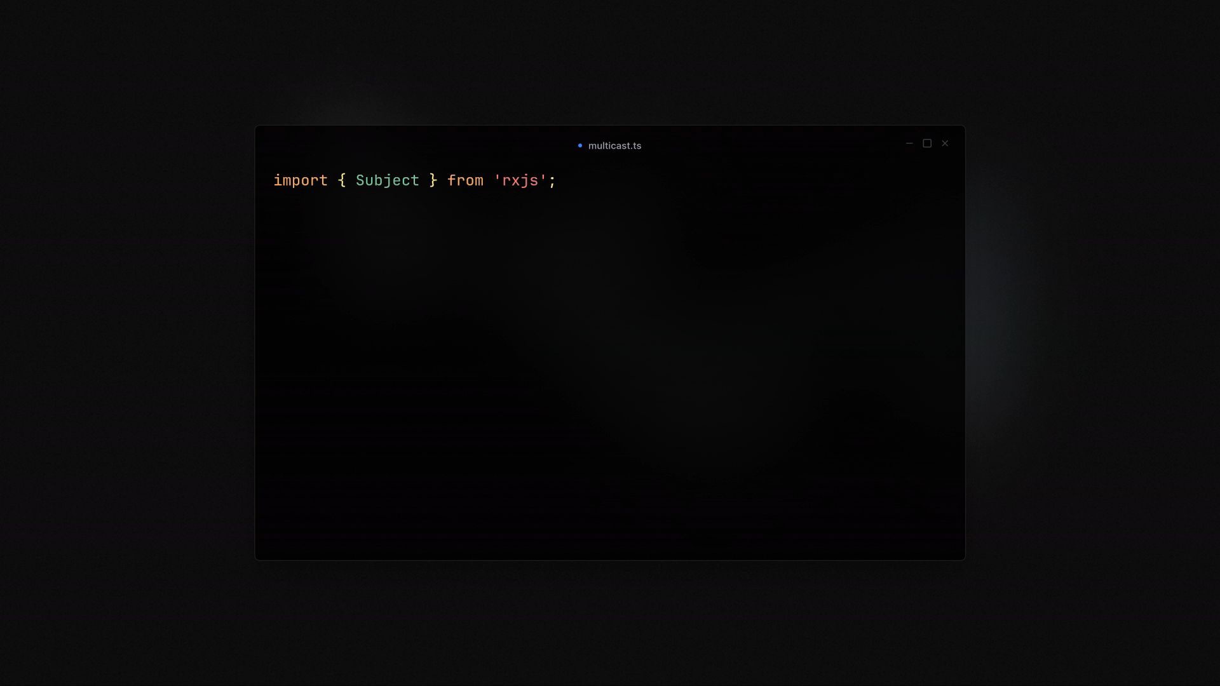

Slide 28
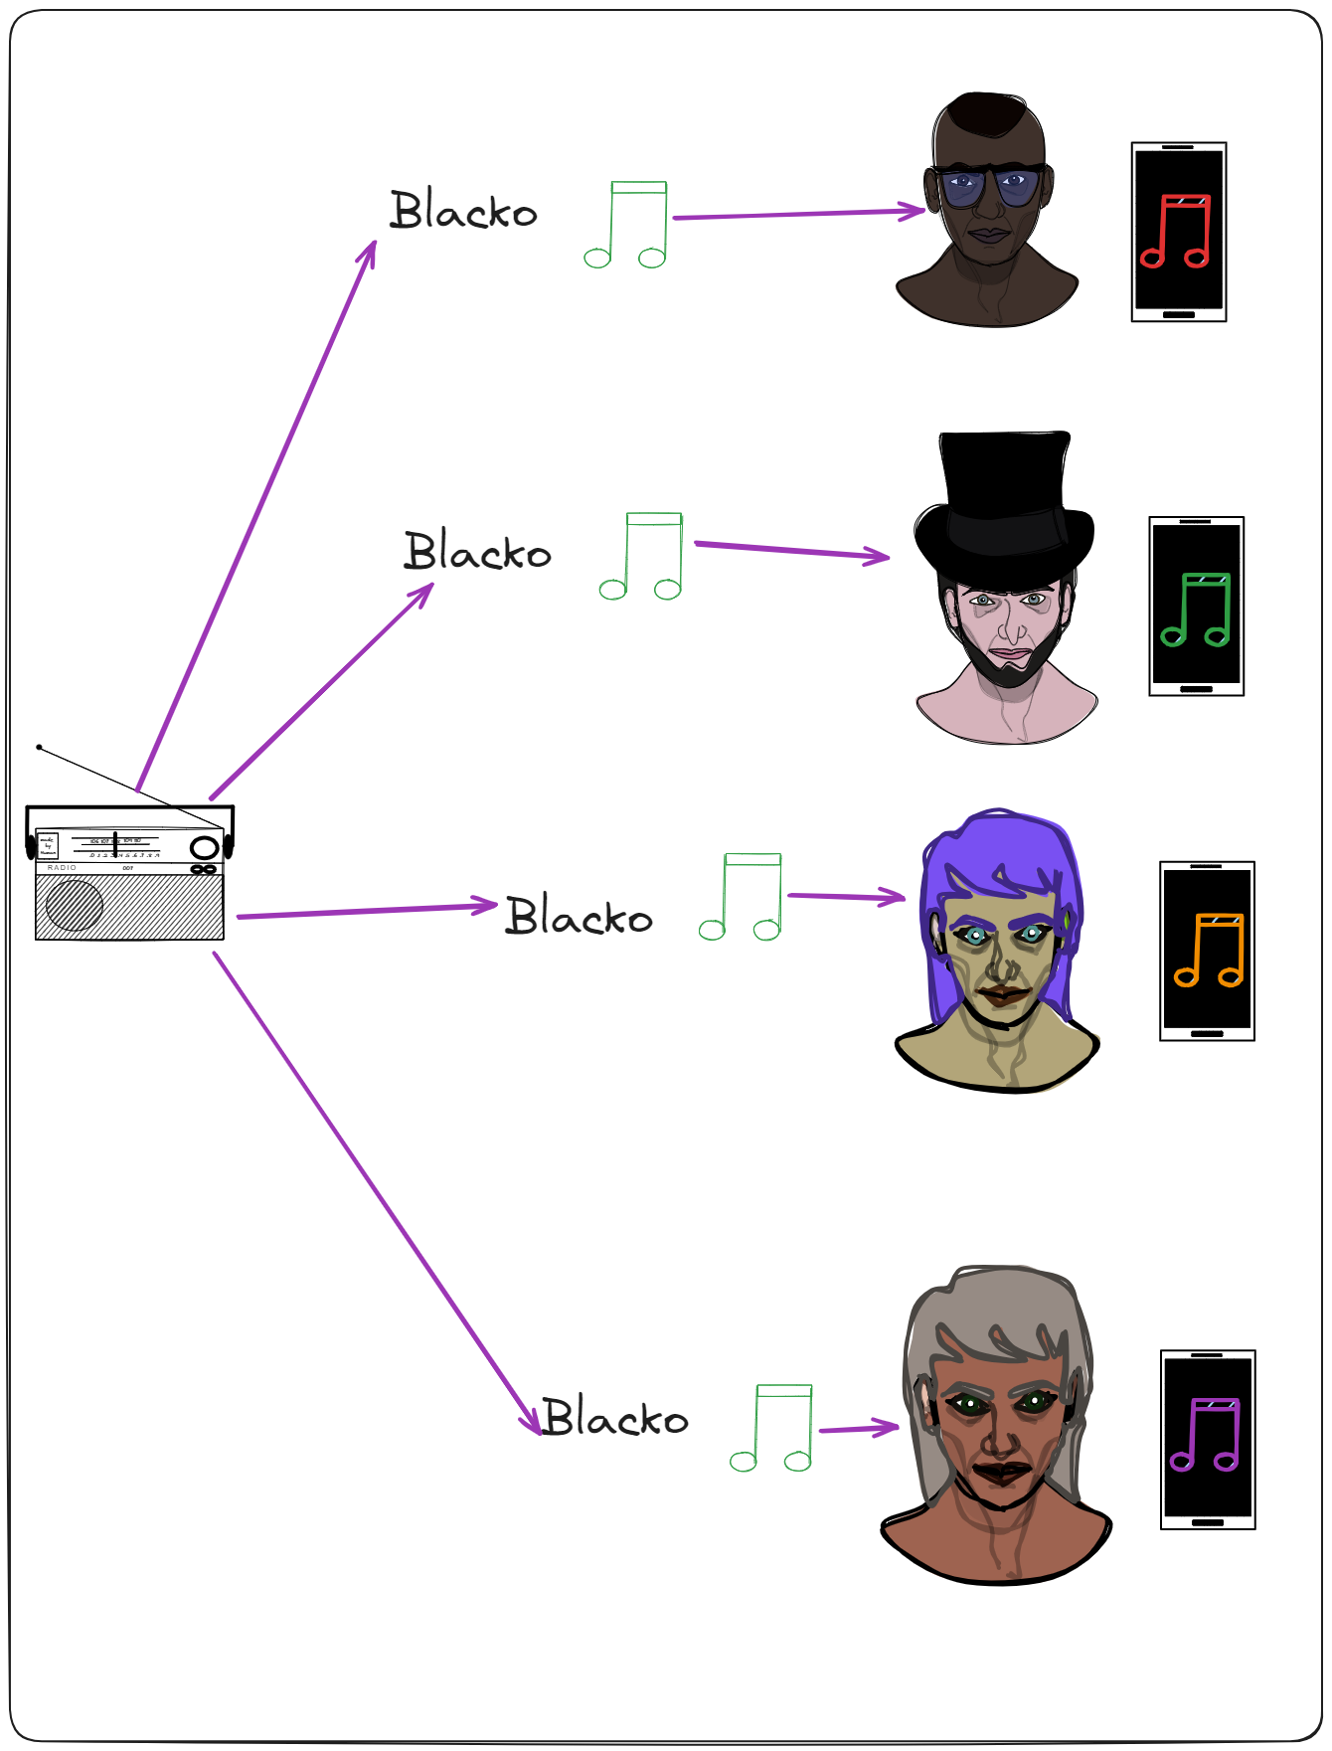
Creating observables in angular: Observables– unicast (one-to-one relationship)
Unicast Observables are those where each subscribed observer owns a separate execution of the Observable.
This means that each observer will receive a unique set of emitted values.
Each observer subscribed to a Unicast Observable has its own instantiated instance of the data producer.
Observable is unicast because each observer has its own instance of the data producer.
server

Slide 29
